Slide 1

PY - ARCADE
GROUP MEMBERS -
JAHNAVI MANOJ 160120733003
SHIRISHA SIDDIREDDY 160120733015
CHETAN PANDE 160120733027
PUNNEETH BATCHU 160120733039
ABDUL KHADER 160120733051

Slide 2
ABSTRACT
Py – Arcade is a collection of games which can be played with a computer or with a friend. The arcade was developed in python using tkinter module. Both console and GUI games are supported. Scores of the games can be accessed through an excel file.

Slide 3
SOFTWARE SPECIFICATIONS
Develop a main screen from which individual games can be launched by clicking the game icon.
Each game is its own module with can be called from the main module.
At the end of a game, the game module should save the result into an excel sheet using openpyxl module that has to be downloaded separately.

Slide 4
MODULES IN GAME
Guess the number
Dots and Boxes
Guess the color
Tic Tac Toe
Hangman
Mad Libs
Escape Room
Rock Paper Scissors

Slide 5
GUESS THE NUMBER
Number of players:– One
Application type:– IDLE terminal window
How to play : -
A random number is chosen by the compiler in a range entered by user.
The user has to guess the number in minimum number of guesses.
A message will be displayed with score when user wins or loses the game.

Slide 6
Variables in the game:
Lower bound, upper bound for storing the range.
Count, score variables.
Logic:
User inputs the lower bound and upper bound of the range.
The compiler generates a random integer between the range and store it in a variable for future references.
For repetitive guessing, the count variable will be iterated.
If the user guessed a number which is greater than a randomly selected number, the user gets an output “Try Again! You guessed too high“
Else If the user guessed a number which is smaller than a randomly selected number, the user gets an output “Try Again! You guessed too small”
And if the user guessed in a minimum number of guesses, the user gets a “Congratulations! ” Output.
Else if the user didn’t guess the integer in the minimum number of guesses, he/she will get “Better Luck Next Time!” output.

Slide 7

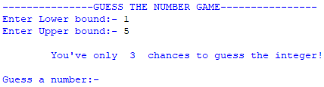


Guess My Number:-
When the start_game function is called:
When user gives the range:
If a number more than the guess is given:
If a number less than the guess is given:

Slide 8


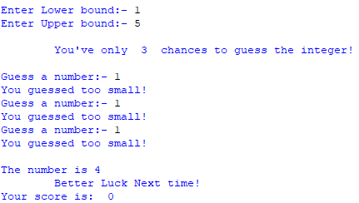
5. If the correct number is guessed in 1 try:
6. If the correct number is guessed in more than 1 try:
7. If correct number was not guessed:

Slide 9
DOTS AND BOXES
Number of players:– Two(Computer Vs User or User vs User)
Application type:– IDLE terminal window
How to play : -
Select the dimensions of boxes grid.
Tell whether you want to play with computer or not.
If you are playing with computer, then just join any 2 dots and try to gain boxes in your turn and wait for the computer to complete its turn.
Else keep joining the dots in corresponding player turns and try to gain boxes.
Player with more number of boxes will be the winner.

Slide 10
Variables in the game:-
Dots as a nested list.
Horizontal and vertical links for lines between any two dots.
Owners, a nested list for owners of a box.
Score for storing score of each player.
Logic:-
User gives size of the board as input then create dots grid without any links between them.
Let the column numbers of dots be alphabets and row numbers be numbers.
Ask the user(s) to input two position of dots until a valid point is given by the user(s).
If any player gains a box then he gains a point and chance.
Else the player will change.
If the 2nd player is not computer then game continues in this way.
Else the computer will be called to play using a function.
The computer will always first search for such position of dots where it can try for a box and if possible gains it. Otherwise it searches a position where the opponent can gain less number of boxes. The game will be iterating until all boxes are owned by users.

Slide 11
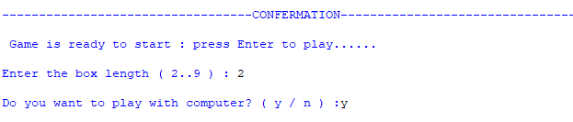
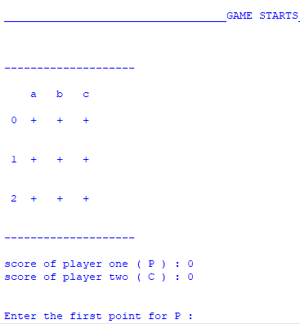
Dots and Boxes:-
When the start_game function is called:
When the dots grid is created:

Slide 12
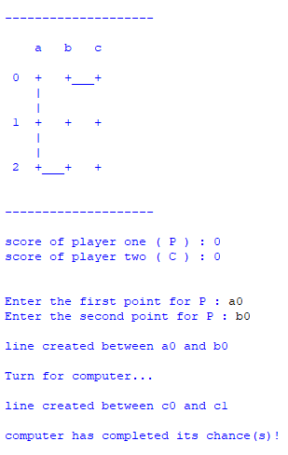
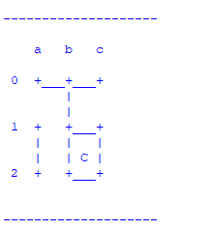
3. When few links are created:
4. When a box is created:

Slide 13
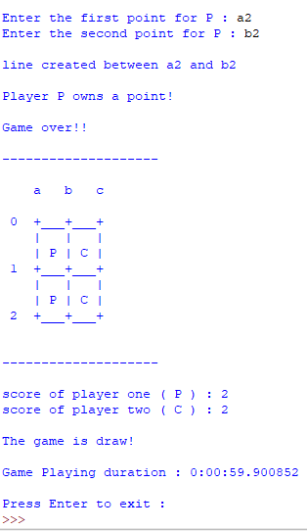
5. Game ends:

Slide 14
GUESS THE COLOUR
Number of players:– One
Application type:– GUI using tkinter.
How to play : -
In this game player has to enter color of the word that appears on the screen and hence the score increases by one, the total time to play this game is 30 seconds.
Colors used in this game are Red, Blue, Green, Pink, Black, Yellow, Orange, White, Purple and Brown.
Interface will display name of different colors in different colors. Player has to identify the color and enter the correct color name to win the game.

Slide 15
Variables in the game:-
Colours for giving the colours which we wants to use in game.
Score for storing the score of the player.
Timeleft for showing the remaining time for the game.
Logic:-
User enters the gussed colour of the shown text in the text box given.
Initially your score will be zero.
If the colour you gussed, matches the colour of shown text, your score will increase by one.
Else your score remains same.
The time limit will be of 30 seconds.
After 30 seconds, your Final score will be displayed.
Console asks us whwther we want to play again? , type “Yes” if you want to play again, Else type”No”.
Try to guess more colours in given time , then you will be the winner.

Slide 16
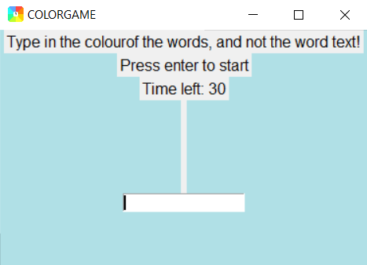
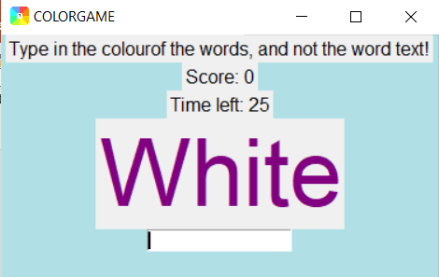
GUESS THE COLOUR
Press “Enter” to start the game
Guess the colour of word and enter in the text box.
Try to guess more colours within time to win the game.

Slide 17
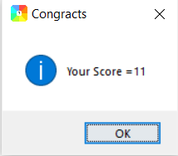


Your Final score will appear like this.
It will ask us whether we want to play again or not.
If we type “Yes” , we can play again
If we type “No” , it will end by showing “Thank you for playing”

Slide 18
TIC TAC TOE
Number of players:– Two(Player Vs computer or Player vs Player)
Application type:– GUI using tkinter
How to play : -
Play occurs on a 3 by 3 grid of 9 squares.
We need to select single player or multi player
Two players take turns marking empty squares, the first marking X’s, the second O’s.
If one player places three of the same marks in a row, the player wins.
A row is any three squares on the grid, adjacent diagonally, vertically or horizontally.
If the spaces are all filled and there is no winner, the game ends in a draw.

Slide 19
Variables in the game:-
Sign
Board
Str1
Logic:-
Firstly we have to select the mode of game either singleplayer or multiplayer.
Then 3 X 3 grid with 9 boxes would appear.
Both players should go on keeping their respective letters in boxes when their turn comes.
The player who starts the game will plot letter “X”.
The other player will plot “O”.
The player who first matches 3 of his letters in a row, will win the game.
Row means in any direction :vertical (or) horizontal (or) diagonal.
If you wants to play again type “Yes” in console.

Slide 20
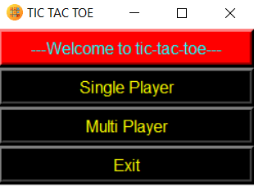
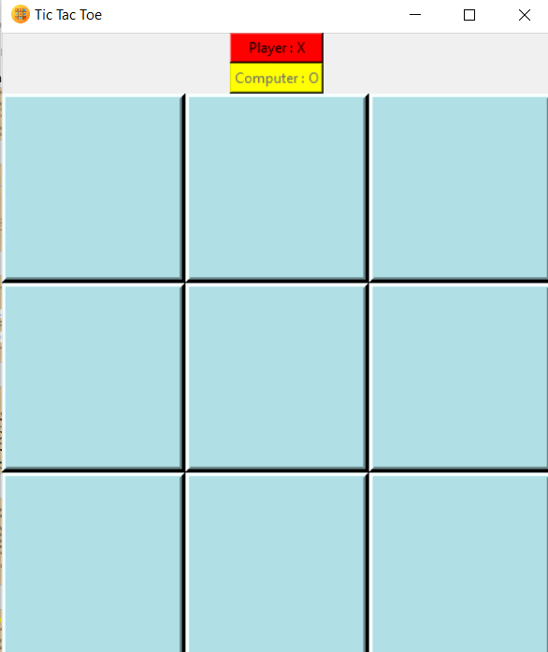
TIC TAC TOE
Here we can select mode we want
3 x 3 grid will appear as shown in this figure
We have to click on box , at which we need to place our letter
If we match 3 letters first , we are the winner.

Slide 21
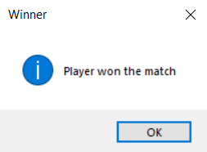
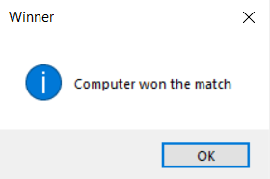
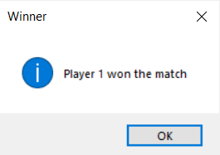

In single player mode:
In multiplayer mode:

Slide 22
HANGMAN
Number of players – single player
Application type – GUI console using tkinter
How to play : -
A random word is chosen from a list.
A blank is shown for every letter in that word.
If the player enters a letter that occurs in the word, the blanks are replaced with that letter.
If the word does not contain the suggested letter, a turn is deducted from the turns left
The word must be guessed before the number of turns run out.

Slide 23
Game state variables –
number of guesses remaining
guessed letters so far.
Logic : -
Show game window using tkinter
When enter button is clicked
Letter in the entry is taken as input
Entry is cleared for the next letter
If letter is in the word, print the letter at that position on the screen
Else, deduct 1 from the number of turns
If turns runs out – show game lost message
Else if word is guessed correctly – show game won message

Slide 24
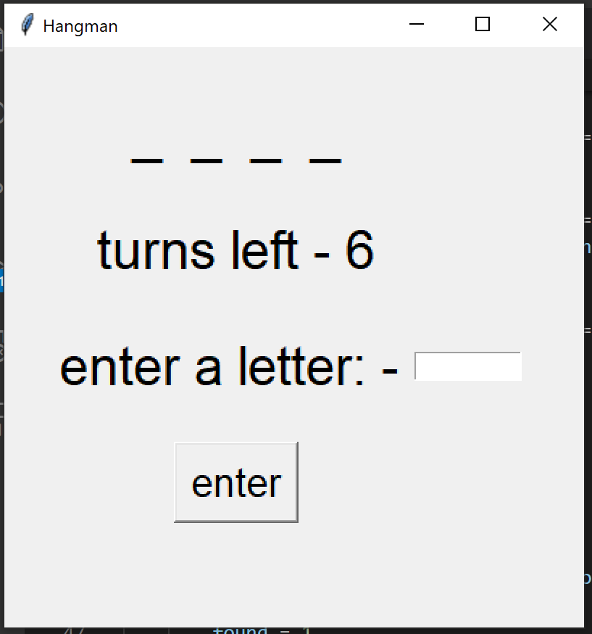
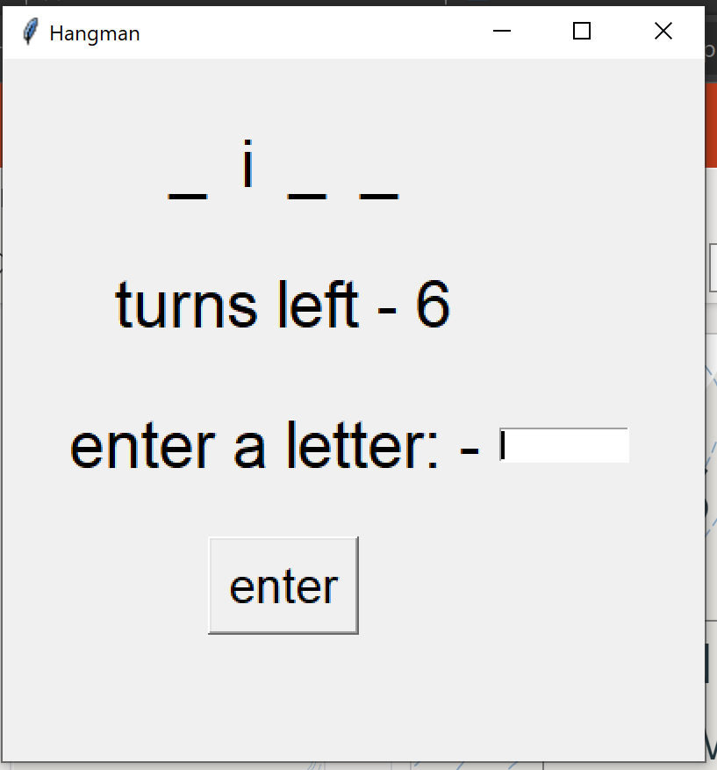
HANGMAN
When hangman function is called
If a letter in the word is entered

Slide 25
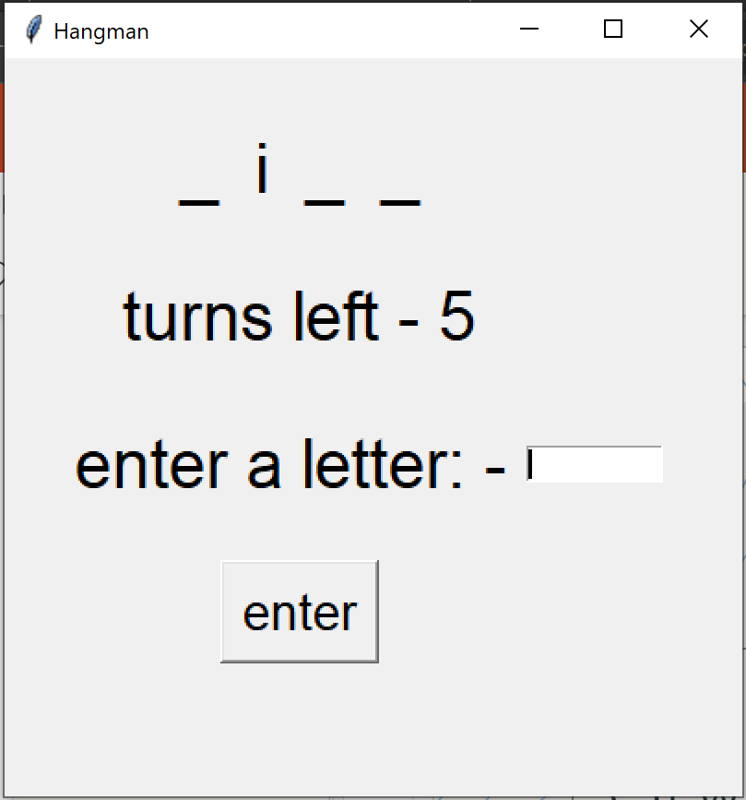
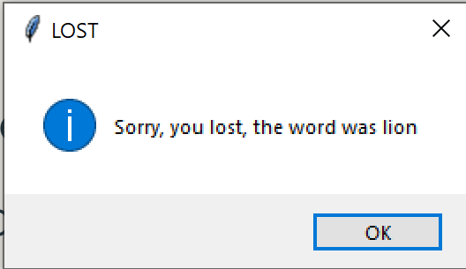
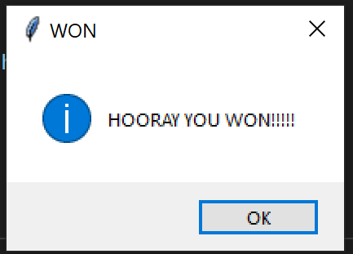
3. If wrong letter is entered
4. if turns run out
5. if the word is guessed correctly

Slide 26
MAD LIBS
Number of players – Multiplayer
Application type – IDLE terminal window
How to play : -
Both the players are first asked for verbs, nouns etc. without any context.
The nouns and adjectives entered are placed into blanks of a pre-prepared story.
The stories of both the players are displayed.
The winner of the game is the player whose story is funnier.

Slide 27
Input : - verbs, nouns, adjectives, parts of body etc depending upon the game
Output : - a story containing the words entered capitalized.
Logic : -
String inputs are taken
Story is displayed in the form of a paragraph using concatenation.
The winner of the game is recorded.

Slide 28
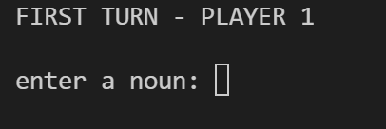
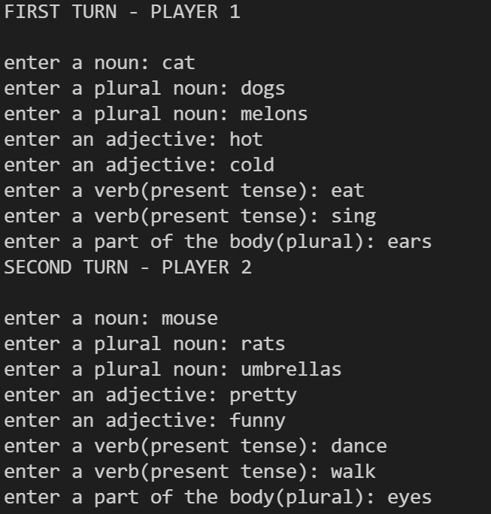
MAD LIBS
When the function is called
When input is given by both players

Slide 29
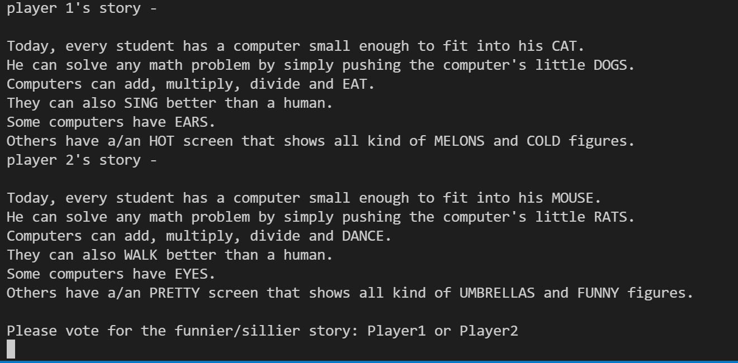
3. after input is given by both players

Slide 30
ESCAPE ROOM
Number of players : single player
Application type : IDLE terminal window
How to play :
Here, Escape room game is designed by using python
In this game ,The user sleep in his room at night. At morning, when he wakes up ,
He will be in the dark room which is unknown to him. In order to escape from the
room the user have to fight with monster/attacker .
Here the user gets three options to choose, according to selected
option the user needs to play the game. If he wins, he escapes from the room.

Slide 31
Input : Takes user inputs regarding the levels of game
Output : points of the players and the winner of the game
Logic of game :
Here at first , user and monster were given with some equal health points each
The user have to select one among the three options in the room
1. Left door
2. Right door
3. Sit there for a minute
If the user chooses right door , the monster health points will get doubled. It is hard level of the game
If the user chooses to sit in room for a minute, he loses some points. It is medium level of the game
If the user chooses left door, both points remain same. It is easier level of the game
Then the user have to select wheather to fight or flee with monster.
If user select to flee , he loses game

Slide 32
If the user selects fight , he have to fight with monster to get out of the room
When user attacks monster, monster loses some points
When monster attacks user, user loses his points
The fight continues till anyone of the gamer points reduces to less than one.
If user health points reduces to less than one first , he will be died by the monster.
If monster health points reduces to less than one first, user wins the game and can be escaped from the room

Slide 33
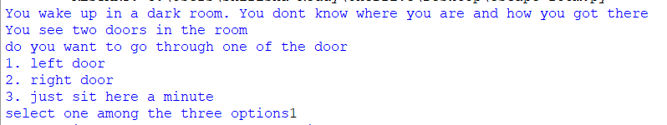
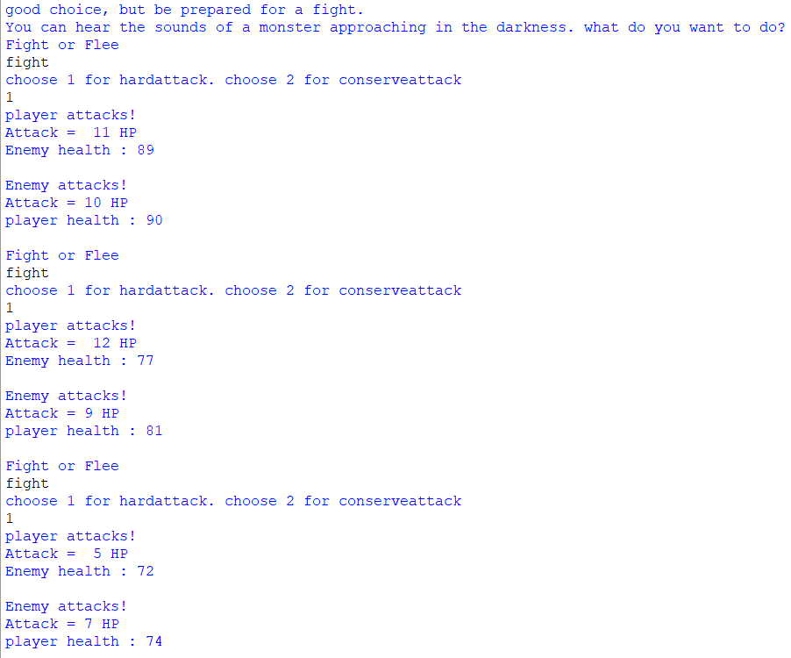
Escape Room
Ask user to choose one among the
given options
Displays monster and user points
after every attack

Slide 34
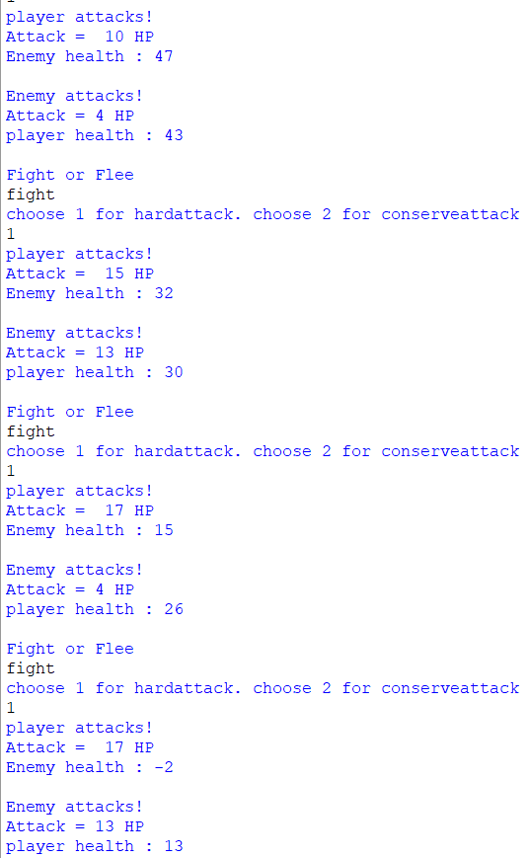

Game is continued till any one of the
gamers health points reduces to less than
one
Here finally prints the winning status of
the user in the game

Slide 35
ROCK PAPER SCISSORS
No of players : single payers
Application type : IDLE terminal window
Here we need to remember three key points to play the game.
1. Rock smashes scissors.
2. Paper covers rock.
3. Scissors cut paper.
This game will be played in three rounds and the highest scorer of those three rounds will be determined as winner

Slide 36
Input : Takes user input of one among the three options
Output : players points and the final winner
Logic :
When computer selects rock :
If user chooses scissors, computer wins
If user chooses rock, game will be tied
If user chooses paper, user wins
When computer selects paper:
If user chooses rocks, computer wins
If user chooses paper, game will be tied
If user chooses scissors, user wins

Slide 37
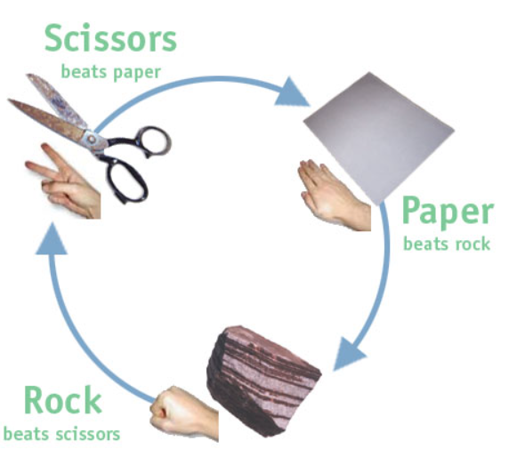
When computer selects scissors :
If user chooses rock, user wins
If user chooses paper, computer wins
If user chooses scissors, the game will be tied

Slide 38
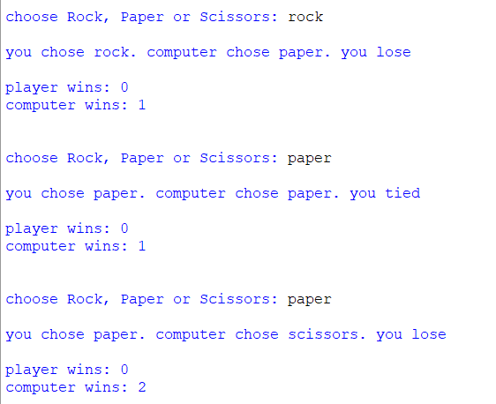
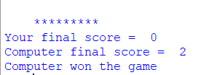
Rock paper scissors :
Displays three options to user in each round
Determines winner of each round
Prints user and computer points In every round
Displays final score of user
Displays final score of computer
Prints winner of the game

Slide 39
RECORDING RESULTS
Application Type: IDLE Terminal window
Recording Sheet Type: EXCEL sheet
Concept:
The scores values can be copied into excel sheet via openpyxl module
The openpyxl module can be downloaded via command prompt within the directory where python is located]
At first the location of the excel sheet has to be given, since this is python, the excel sheet can be saved anywhere and can be accessed via entering the location.
Then, a workbook object is created which will represent the file.
Later, the current page is accessed via active command.
Then after, different values(scores) can be written on to the different blocks of the excel via denoting the row and column of the specific block.
This is preferred because of the range of files that could be accessed via this module.

Slide 40
Working Logic
For different games, the name of the game would be appended as the heading for the new column via max_column function.
There after, in accordance with the game and the choice of the user, the type of game is accessed and copied which would be a single player game or a multiplayer.
Then, The number of times that particular game is played for the moment is appended in the third row.
With taking different scores and factors under consideration, the scores are being copied in the particular cells representing the two players.
Every time when the game’s progress is updated, it is verified that the previous column does not represent the results depicting the sum of entire scores up to that point. If it is encountered, then that particular column is first deleted and then, the observation is updated.
Since, the games are basically of two types, the structure of the added on object representing the code differs.

Slide 41
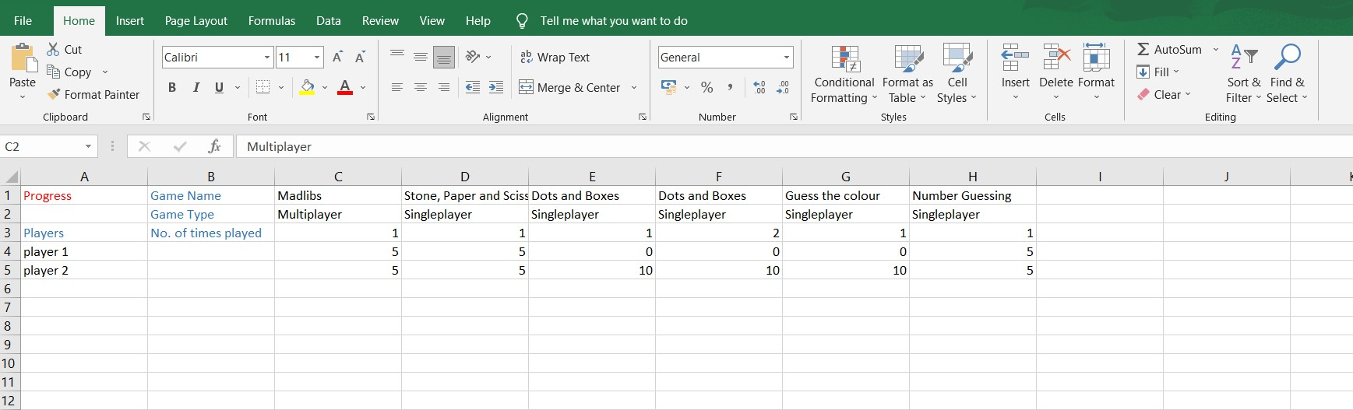
Output Analysis
First row represents the name of the game played.
Second row represents the type of game played.
Third row represent the progress of the number of times the game has been played.
The last two rows represents the scores for that particular game.

Slide 42
RESULTS
The results which are to be displayed can be one of the two types, a) Momentary result b)Final result
Momentary result is obtained and displayed when all the 8 games are not played. This is to know the current progress and the games that are still to be played to obtain the final evaluation
Final result is obtained when all the 8 games are played at least once with declaring the winner of the tournament
The result is obtained via finding the sum of scores and appending it into the new row named as result and then comparing the scores of both the players.
If already, the result column is obtained, then normal evaluation is done.
In the result program, the suitable result is obtained by comparing by checking whether all the 8 games’ names are available in the first row(accordingly momentary or final result is displayed)

Slide 43
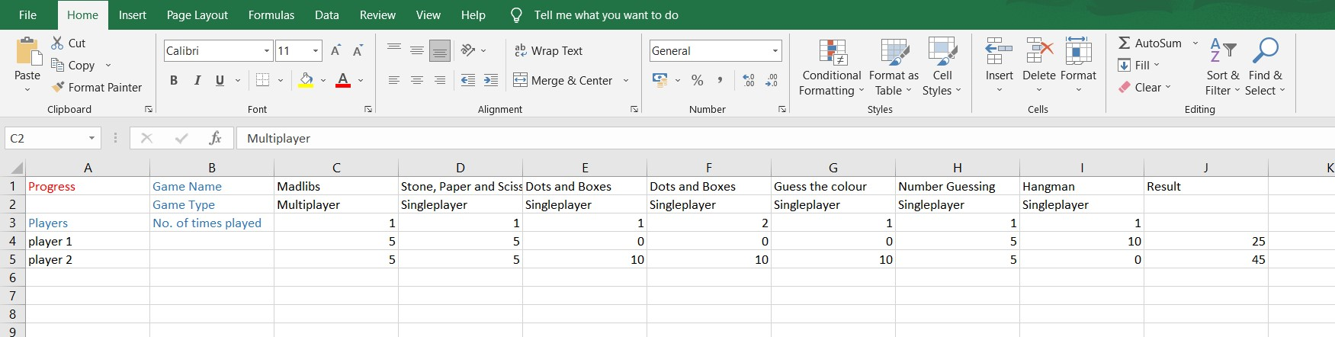
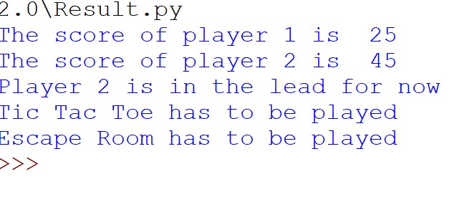
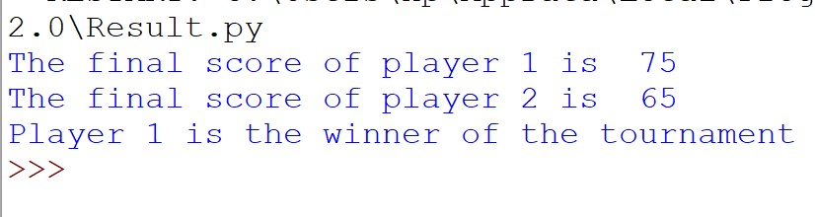
Different Outputs

Slide 44
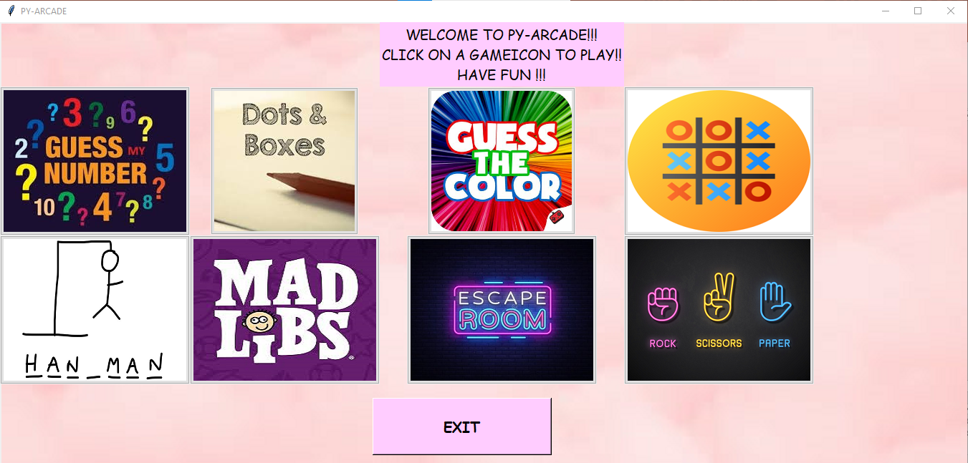
MAIN WINDOW Py-Arcade

Slide 45
CONCLUSION
While working on this project, we were able to solidify the basics in python, learn to access modules from another, learn to use tkinter to make GUI based applications.
We have made an extensible game package where new games can be easily added or removed, games that can be played with friends or without the computer.

Slide 46
REFERENCES
Python documentation: -
3.9.6 Documentation (python.org)
Openpyxl documentation: -
openpyxl - A Python library to read/write Excel 2010 xlsx/xlsm files — openpyxl 3.0.7 documentation

